Slide 1
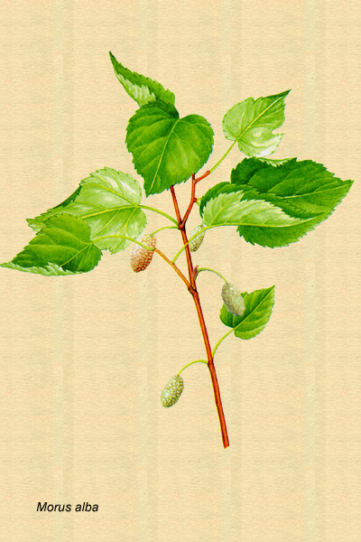
glucoPHYTON
Rationale of the project and description of ingredients

Slide 2
OBJECTIVES
Design of a phytonutraceutical formulation to:
Control post-prandial plasma glucose levels by
A) reducing glycemic index of food
B) increasing glucose excretion
Reduce the synthesis of Advanced Glycation End products (AGEs)
Reduce the synthesis of Advanced Lipoperoxydation End Products (ALEs)
As a consequence of these goals, to prevent and/or to decrease complications of diabetes

Slide 3
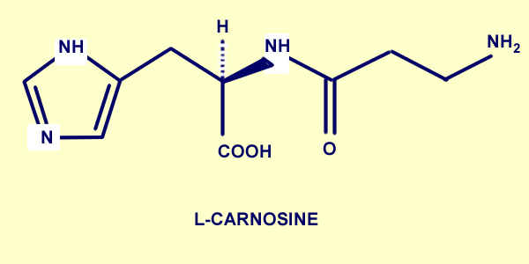
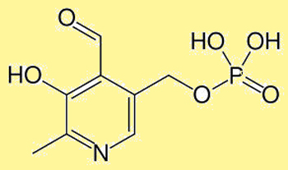
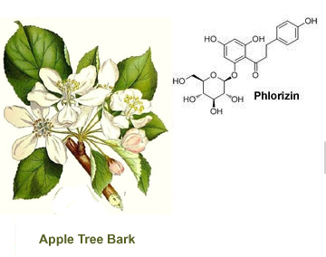
INGREDIENTS
L-carnosine
Pyridoxal-5-phosphate
Morus alba
Innovative blend combining inhibitors of Glycosidase, inhibitors of SGLT-2 (sodium-glucose cotransporter 2) and inhibitors of the synthesis of Advanced Glycation End products and the synthesis of Advanced Lipoperoxydation End products

Slide 4
Apple TREE BARK
Pharmacological Evidences
Phlorizin is a well-known SGLT-2 inhibitor, causing glucosuria both in dogs and
humans

Slide 5
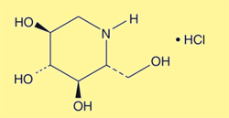
1-deoxynojirimycin (DNJ) and some
of its derivatives are well known as an alpha-glucosidase inhibitors
PHARMACOLOGICAL EVIDENCES
CLINICAL EVIDENCES
Randomized open, cross-over study in 10 healthy women given M.alba extract and selected carbohydrates
Suppresion of post-prandial blood glucose and insulin levels

Slide 6
PHARMACOLOGICAL EVIDENCES
Carnosine inhibits in vitro low-density
Lipoprotein oxydation
Carnosine delays senescence of human
cultured diploid fibroblasts
CLINICAL EVIDENCES
Randomized double blind placebo controlled
study of effects on cognition and mood in
the healthy elderly volunteers
Working memory (Bond-Lader visual analogue
Scales) increased in 28 subjects after two months
of treatment.

Slide 7
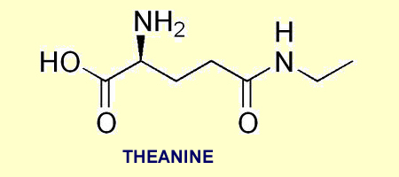
PHARMACOLOGICAL EVIDENCES
Decrease of beta-amyloid-induced
cognitive dysfunction and neurotoxicity
Protective effect on Abeta(1-42)-induced
neuronal cell death and memory impair-
ment of mice.
CLINICAL EVIDENCES
Double blind, placebo controlled study of effects of 100 mg of L-theanine
+ 50 mg of caffeine on EEG and scores of attention tests in 16 healthy
volunteers
Double blind, placebo controlled study of effects of 100 mg of L-theanine
+ 50 mg of caffeine on cognition and mood in healthy volunteers.

Slide 8
INDICATIONS
HEALTHY
Increase of attention and short term memory
Increase of cognitive function
Increase of alertness
Decrease of neuronal degeneration due to senescence, toxins
and oxidative damage
PATIENTS
Decrease of neuronal degeneration in Alzheimer patients
Protective effect on environmental toxins-induced neuronal cell death
Mood improvement in children with attention deficit with hyperactivity

Slide 9
SUMMARY
New formulation not described else where
Activity of ingredients demonstrated in “vitro” and “in vivo
pharmacological studies
Well known and safe ingredients, most of them with a specif monograph in
US Pharmacopea and/or other pharmacopeas
Ingredients easyly available
All the ingredients have shown beneficial effects on cognitive function,
memory and mental altertness in Evidence Based Clinical Trials
Formulation useful in children, adults and elderly
Formulation likely useful because it considers most of the known mechanisms involved in cognitiva function

